Slide 2
C(n,r) = n ! / [ r ! (n-r) !]
C (5,2) = 5 ! / [ 2 ! (5 -2) !] = (5 x 4 x 3 x 2 x1 ) / [ (2 x 1) (3 x2 x1]=
120 /[ 2 x 6] = 10
0 ! = 1
N ! Bagaimana membuat programnya ?
long n, nfak=1;
If (n == 0 ) nfak = 1;
else for (int i =1; i <= n; i++) nfak = nfak * i;

Slide 3
long n, nfak=1;
If (n == 0 ) nfak = 1;
else for (int i =1; i <= n; i++) nfak = nfak * i;
----------------------------------------------------------------------
Bagaimana menghitung C(n,r) ?
Hitung n !
Hitung r !
Hitung (n-r) !
Hitung n! / (r ! (n-r) !)

Slide 4
long n, r,cnr;
Baca n dan r;
// hitung n !
long nfak =1;
if (n == 0 ) nfak = 1;
else for (int i =1; i <= n; i++) nfak = nfak * i;
// hitung r !
long rfak = 1;
if (r == 0 ) rfak = 1;
else for (int i =1; i <= r; i++) rfak = rfak * i;
// hitung (n-r) !
long nrfak =1;
if (n == 0 ) nrfak = 1;
else for (int i =1; i <= n-r; i++) nrfak = nrfak * i;
//hitung C(n,r)
cnr = nfak / (rfak*nrfak);

Slide 5
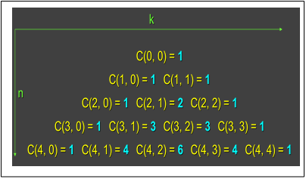
Buat loop untuk menghitung C(n,r) dari C(0,0) sampai C(n,r)
Andaikan n = 3
for (int i = 0; i<=n; i++) {
for(int j=0; j<=n; j++) {
hitung C(i,j);
tampilkan C(i,j)
}
cetak baris baru;
}

Slide 6
long n, r, cnr;
Baca n dan r;
for (int i = 0; i<=n; i++) {
for(int j=0; j<=i; j++) {
// hitung i !
long ifak =1;
if (i == 0 ) ifak = 1;
else for (int k =1; k <= n; k++) ifak = ifak * k;
// hitung j !
long jfak = 1;
if (j == 0 ) jfak = 1;
else for (int k =1; k <= j; k++) jfak = jfak * k;
// hitung (i-j) !
long ijfak =1;
if ((i-j) == 0 ) ijfak = 1;
else for (int i =k; k <= i-j; k++) ijfak = ijfak * i;
//hitung C(I,j)
cij = ifak / (jfak*ijfak);
Cetak(cij);
}
}

